Slide 1
Project M:UPDATE
Airventure 2026

Slide 2
Or…Adding a 6th Category?
Introduction
Background/Category Creep/Legacy
White Paper Presented at the end of the Board meeting in 2023
Further Development
Roadmap to Exploration
Update: Rules, sequences and a provisional Unknown catalog
Feedback/Q&A

Slide 3
Organizing Princples
“to tie performance to a known capability within a substantial part of the US aerobatic fleet, making competition more accessible, sustainable and engaging to the needs of a broader audience”
Create More Runway for a competition career that does not seek advanced/UNLimited flying increasingly controlled by CIVA (see CIVA INT; UK, France for example)
Create more runway for legacy aircraft

Slide 4


Rules Summary
Penalties:
Out 15; Interruption 35; Jury penalty 150
High 15
Low (100 feet): 90
Low Low (200 feet): zero performance
Known ~240K
Free 240K, 15 figures
Unknown 8-12 figures and 220K

Slide 5












 |  | ¼ | ½ | ¾ | 1 | 1¼ | 1½ | 1¾ | 2
9.1.1 |  | 6K | 8K | 10K | 12K | 14K
 |  | IMAU | MAU | A¹U | U | U
9.1.2 |  | 4K | 6K | 8K | 10K | 11K | 12K
 |  | U | IMAU | U | IMAU | U | U
9.1.3 |  | 2K | 4K | 6K | 8K | 9K | 10K | 11K | 12K
 |  | MAU | IMAU | MAU | IMAU | U | IMAU | U | AU
9.1.4 |  |  | 4K |  | 8K |  | 10K
 |  |  | IMAU |  | IMAU |  | U
9.1.5 |  | 2K | 4K | 6K | 8K
 |  | IMAU | IMAU | A²U | U
 |  | 1 | 2 | 3 | 4 | 5 | 6 | 7 | 8

Slide 6

Additional Rolls
2X2 45 up
2x4 up and down
3x4 horizontal line
2x8 up, down and Horizontal

Slide 7
Snaps and Spins
Snaps! Add
  Full and Hall snap on 45 up
  Full snap 45 down
Sprins: Add 1 and 1 ½ inverted spins

Slide 8
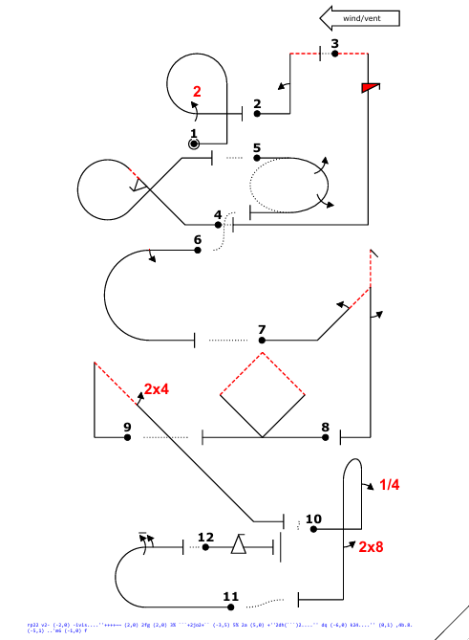
Known
232K

Slide 9
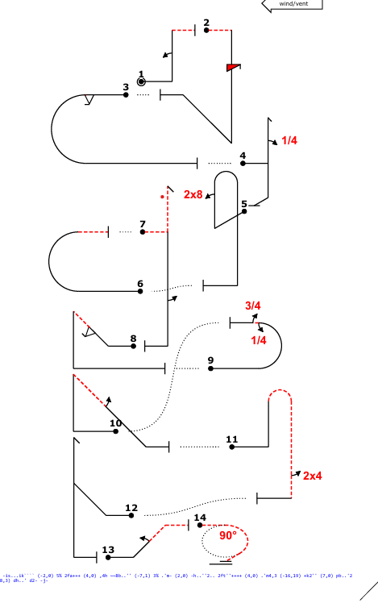
FREE
241K

Slide 10
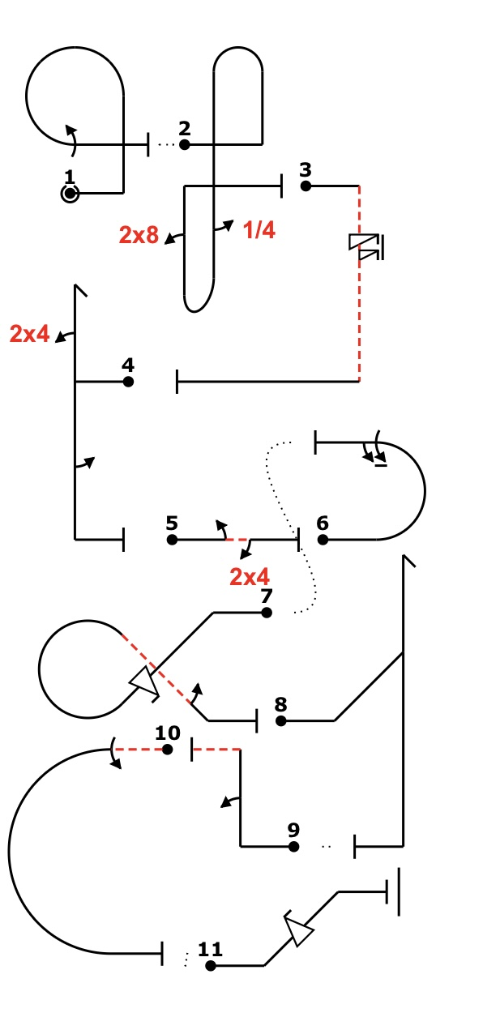
UNKNOWN
221K

Slide 11
Further exploration
The board has committed to no action
Member input and feedback will be crucial to future development and Acceptance
The Board will discuss and may take action at the fall board meeting
If interest, then thoughtful implementation (2027]

Slide 12
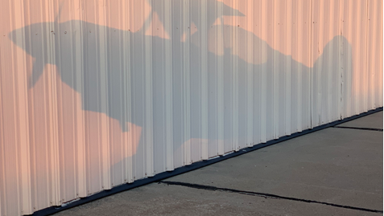
Questions, Comments, Feedback

